Slide 1
CROP DISEASE PREDICTION USING MACHINE LEARNING
su
Under the supervision of
Dr. RATNESH RANJAN
Associate Professor School of
Computer Science & Artificial Intelligence
Presented for
Milestone 3-Final Minor Project Review
Date:26-04-2024
Candidate No. & Name
HTNO. | Name
2203A51L15 2203A51L42 2203A51L56 2203A51L59 2203A51L82 | G.GOVANSH N.NAMITHA V.SRILEKHA T.THRYLOKYA B.SUSHMITHA

Slide 2
Outline of the presentation
1.Abstract
2.Introduction
3.Objectives
4.Literature survey
5.Exsisting system
6.Disadvantages
7.Exsisting methodology
8.Gaps identified
9.Problem identification
10.Proposed methodology
11.Architecture of proposed system
12.Implementation and results
13.Conclusion and future scope

Slide 3
Abstract
Plant diseases affect the growth of their respective species, therefore their early identification is very important. Many Machine Learning (ML) models have been employed for the detection and classification of plant diseases but, after the advancements in a subset of ML, that is, Deep Learning (DL), this area of research appears to have great potential in terms of increased accuracy. Many developed/modified DL architectures are implemented along with several visualization techniques to detect and classify the symptoms of plant diseases. Moreover, several performance metrics are used for the evaluation of these architectures/techniques.

Slide 4
Introduction
Plants are an integral part of our lives because they produce food and shield us from dangerous radiation. Without plants, no life is imaginable, they sustain all terrestrial life and defend the ozone layer, which filters ultraviolet radiations. Tomato is a food-rich plant, a consumable vegetable widely cultivated. Worldwide, there are approximately 160 million tons of tomatoes consumed annually. The tomato, a significant contributor to reducing poverty, is seen as an income source for farm households. Tomatoes are one of the most nutrient-dense crops on the planet, and their cultivation and production have a significant impact on the agricultural economy.

Slide 5
Objectives
Disease Early Detection
Precision Agriculture
Crop Yield Optimization
Economic Sustainability
Environmental Impact

Slide 6
Literature Review
1. Overview of crop diseases: Briefly discussing common crop diseases, their impact on agriculture, and the importance of early detection and prediction.
2. Machine learning techniques: Reviewing various machine learning algorithms and techniques used for crop disease prediction, such as decision trees, support vector machines, neural networks, etc
3. Data sources and features: Describing the types of data used in the studies (e.g., sensor data, satellite imagery, weather data) and the features extracted from this data for disease prediction.
4. Performance evaluation: Summarizing how researchers evaluated the performance of their prediction models, including metrics used and benchmark datasets.
5. Challenges and limitations: Discussing the challenges faced in crop disease prediction using machine learning, such as data availability, model interpretability, and scalability issues.
6. Future directions: Identifying gaps in the existing research and suggesting potential areas for future work, such as integrating advanced machine learning techniques, incorporating multi-modal data sources, and deploying predictive models in real-world agricultural settings.
By synthesizing and critiquing the findings from multiple studies, a literature review provides valuable insights into the current state-of-the-art, challenges, and future directions in crop disease prediction using machine learning.

Slide 7
Exsisiting system
Plant Village:
Description: Plant Village is an online platform that utilizes machine learning for plant disease identification. It allows users to upload images of plant leaves and provides automated diagnosis of potential diseases. The system covers a wide range of crops and diseases.
Website: Plant Village

Slide 8
Disadvantages
1. Data Availability and Quality: ML models require large amounts of high-quality data for training, but obtaining such data can be challenging, especially in regions with limited resources or infrastructure.
2. Overfitting: ML models may overfit to the training data, meaning they perform well on training data but poorly on unseen data, leading to inaccurate predictions in real-world scenarios.
3. Interpretability: Some ML models, like deep learning models, lack interpretability, making it difficult for farmers to understand why a certain prediction was made, hindering trust and adoption.
4. Cost and Complexity: Implementing and maintaining ML systems can be expensive and require technical expertise, which may be prohibitive for small-scale farmers or agricultural organizations with limited resources.
5. Dependency on Environmental Factors: ML models may struggle to accurately predict crop diseases when faced with unforeseen environmental changes or new disease strains, limiting their reliability over time.
Addressing these challenges requires careful consideration of data collection, model selection, interpretability, and ongoing adaptation to changing agricultural conditions.

Slide 9
Exsisting methodology
Machine learning methods for crop disease prediction typically involve gathering data on various environmental factors, crop health indicators, and historical disease outbreaks. This data is then used to train predictive models, such as decision trees, random forests, support vector machines, or neural networks, to identify patterns and correlations between these variables and disease occurrence. These models can then be used to forecast the likelihood of disease outbreaks in specific areas, allowing farmers to take proactive measures to prevent or mitigate crop losses. Data sources often include satellite imagery, weather data, soil composition, and information on crop management practices. Additionally, techniques like image processing and deep learning are used for detecting diseases from images of crop leaves or fields.

Slide 10
Gaps identified
Data Quality and Quantity: One of the primary challenges is the availability of high-quality and sufficiently large datasets. Obtaining labeled data for training machine learning models can be expensive and time-consuming. Additionally, the data may suffer from biases or inaccuracies, leading to reduced model performance.
Imbalanced Datasets: In many cases, the distribution of diseased and healthy crop samples in the dataset may be imbalanced, with fewer instances of diseased samples. This can lead to biased model predictions, where the model may perform well on the majority class but poorly on the minority class.
Generalization to New Diseases and Varieties: Machine learning models trained on existing crop diseases may struggle to generalize to new diseases or crop varieties that were not present in the training data. This is particularly challenging in areas where emerging diseases are common or when dealing with a wide variety of crops.
Real-time Prediction and Deployment: In agricultural settings, timely detection and response to crop diseases are crucial for minimizing yield losses. Deploying machine learning models for real-time prediction in the field requires addressing challenges related to data connectivity, computational resources, and model efficiency.

Slide 11
Problem statement and solution
Developing a Machine Learning model for accurate and timely prediction of crop diseases to enhance agricultural productivity and reduce crop losses.
High-Quality Data Collection: Collecting a diverse and representative dataset of crop images showing both healthy and diseased plants is crucial. Ensure that the dataset covers various crop types, diseases, stages of disease progression, and environmental conditions.
Data Augmentation: Augmenting the dataset by applying transformations such as rotation, flipping, scaling, and adding noise can help increase the variability of the training data, leading to a more robust model.
Model Ensemble: Combine predictions from multiple machine learning models or different variations of the same model to improve overall performance. Ensemble methods such as bagging, boosting, or stacking can help reduce overfitting and enhance prediction accuracy.
Enriching Environmental Data: Incorporate environmental factors such as temperature, humidity, soil moisture, and geographical location as additional inputs to your machine learning model. These factors can provide valuable context for disease prediction and improve accuracy.

Slide 12
Proposed methodology
The problem statement for crop disease prediction using machine learning involves developing a model that can accurately identify diseases affecting crops based on input data such as images of the plants. The solution typically involves:
1. Data Collection: Gathering a large dataset of images of healthy and diseased crops. These images should cover various types of diseases and different stages of crop growth.
2. Data Preprocessing: Cleaning and preprocessing the collected images, which may involve resizing, normalization, and augmentation to ensure uniformity and increase the robustness of the model.
3. Feature Extraction: Extracting relevant features from the preprocessed images. This step may involve techniques like convolutional neural networks (CNNs) to automatically learn discriminative features
4. Model Training: Training a machine learning model using the extracted features. Popular algorithms include CNNs, support vector machines (SVMs), or ensemble methods like random forests.
5. Model Evaluation: Evaluating the trained model's performance using metrics such as accuracy, precision, recall, and F1-score on a separate validation set.
6. Deployment: Deploying the trained model into a user-friendly interface or integrating it into a mobile application or web platform for easy access by farmers or agriculture professionals.
7. Continuous Improvement: Continuously updating the model with new data and retraining it to improve its accuracy and generalization performance over time.

Slide 13
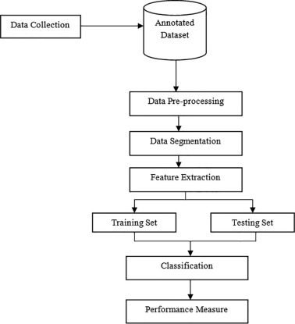
Architecture of proposed system

Slide 14
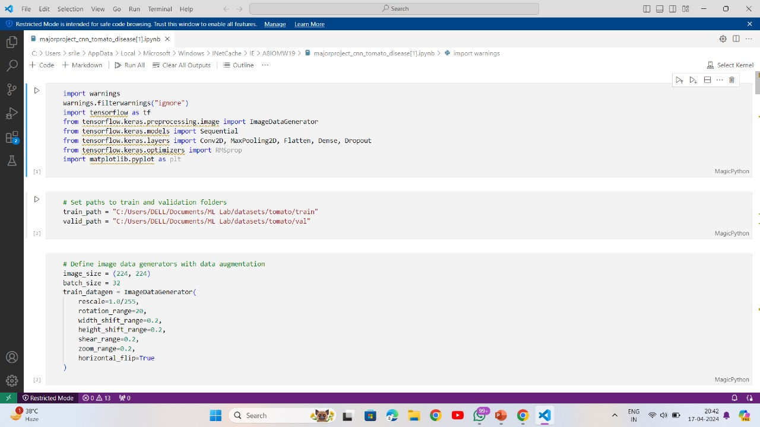
Implementation and results

Slide 15
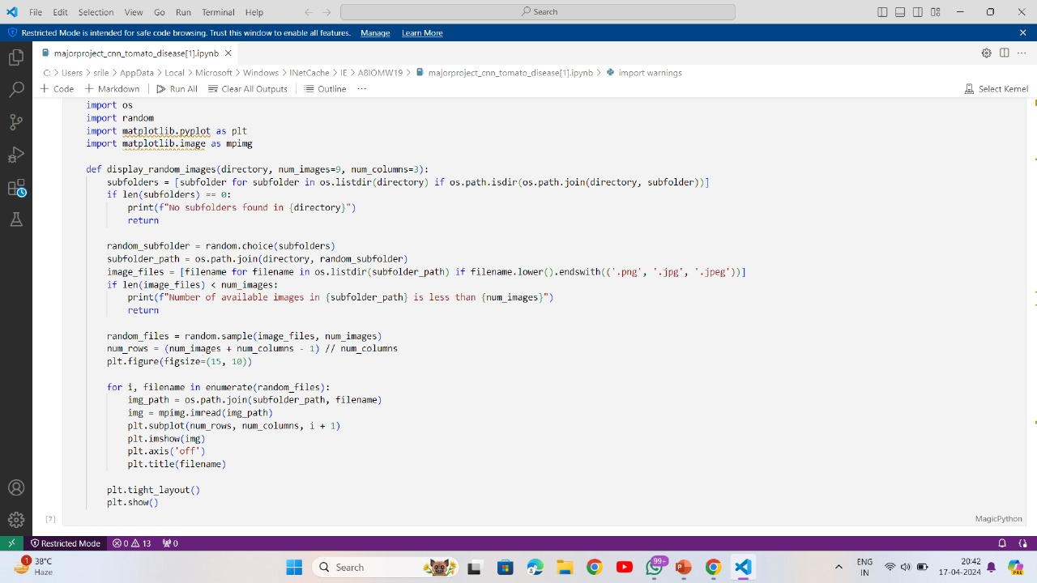

Slide 16
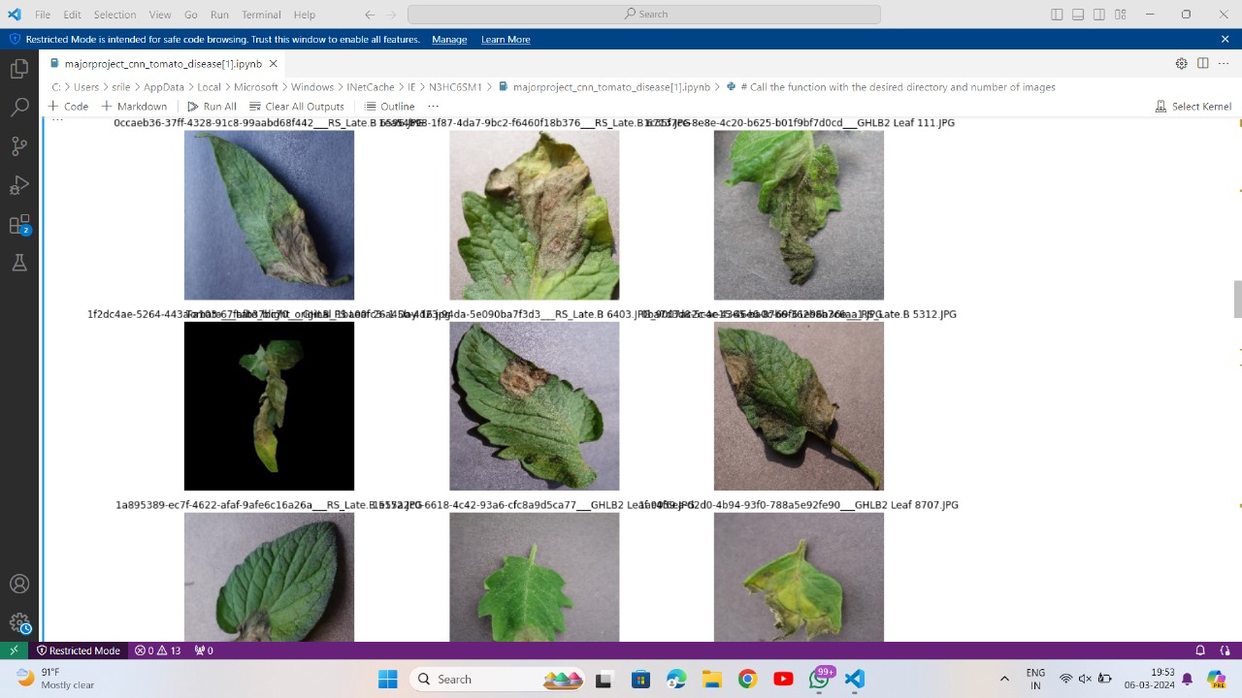

Slide 17
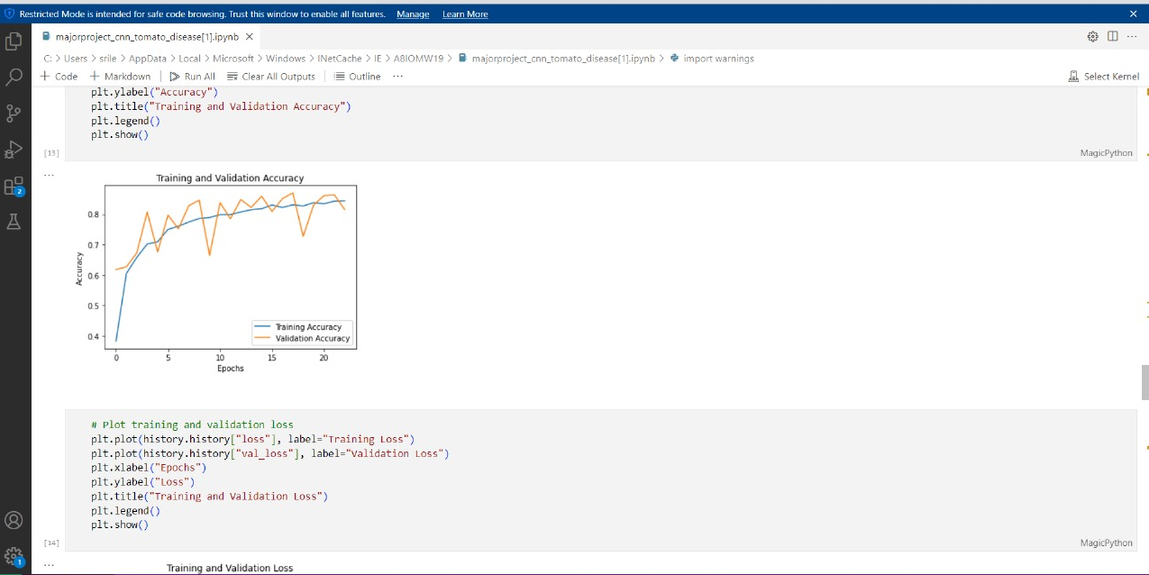

Slide 18
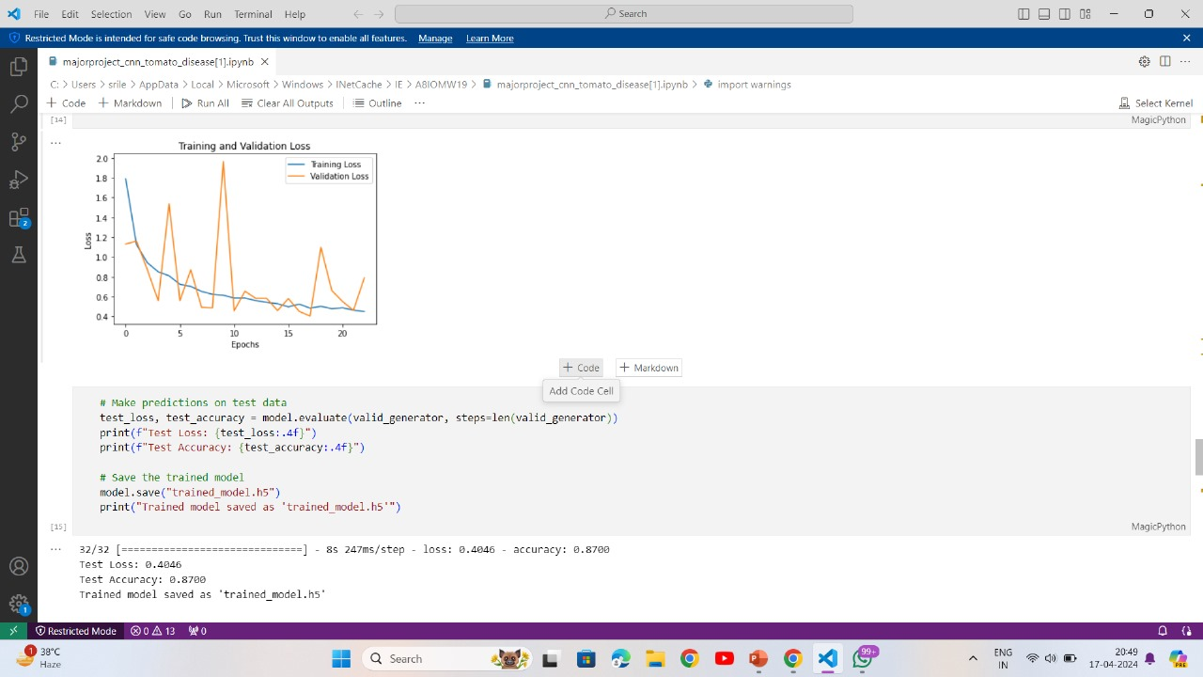

Slide 19
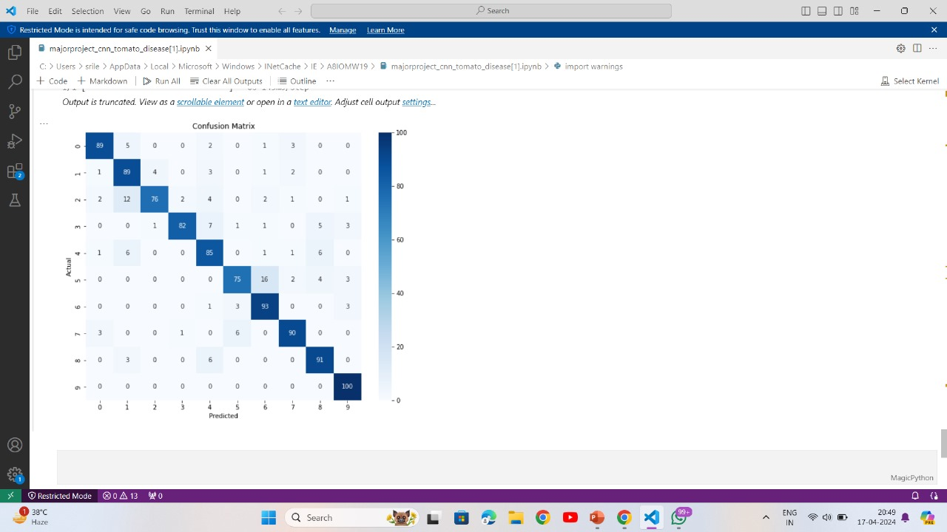

Slide 20
Conclusion and future scope
In this survey presented an insight into existing research addressing the application of ML-based techniques for forecasting, detection, and classification of diseases and pests.
Data-sets containing weather, diseases, and pests data should keep records for long periods of time. Time-series ML models, such as CNN, can be employed to accurately forecast the occurrence of diseases and pests based on meteorological measurements series. NDVI measurements can also be helpful, since they provide additional information regarding the crop’s development.
Detection and classification of pests and diseases can be performed using computer vision and deep-learning algorithms based on CNN models, which show better performance when compared with older image classification approaches based on “manual” features extraction. However, deep learning models require large amounts of data, which can be difficult to obtain. To tackle this issue, the use of transfer learning or few-shot learning methods can prove useful. Nonetheless, although the performance of deep learning-based methods is high for images acquired under controlled conditions, additional research is required regarding the analysis of images taken in the field, under real life conditions.

Slide 21
Thank you

